Slide 1
Team Name
Total presentation time is 7 minutes
Team Members (Name and organization)
Mentors (Name and organization)

Slide 2
App Name
Problem trying to solve
Scientific driver for the chosen algorithm
What’s the algorithmic motif?
What parts are you focusing on?

Slide 3
Evolution and Strategy
What was your goal coming here?
What was your initial strategy?
How did this strategy change?

Slide 4
Results and Final Profile
What were you able to accomplish?
Did you achieve speed up?
(*show multi-core CPU vs GPU numbers)
What did you learn?
Create a new algorithm?
Achieved new scientific goals?

Slide 5
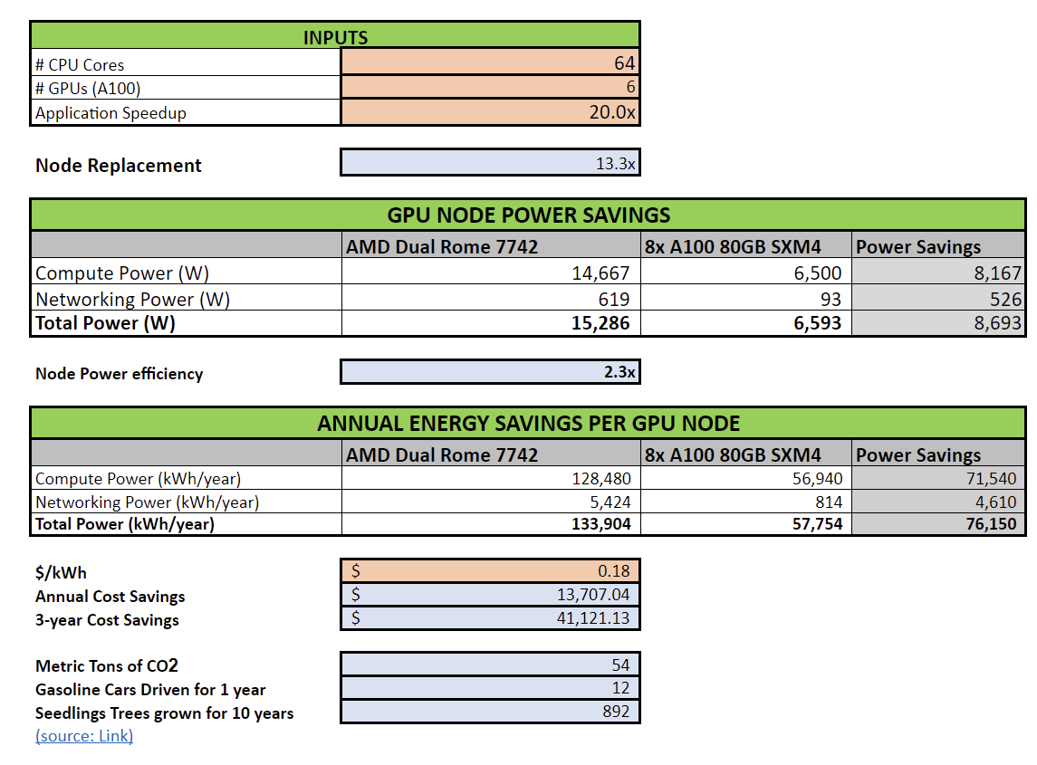
Energy Efficiency
The calculator will compare energy consumption of a number of CPU only nodes with dual CPUs required to perform the same amount of work as 1 GPU node with 2 CPUs and 8 GPUs.
Use this calculator for your report
Add your acceleration numbers in the INPUTS section
Modify $/kwh number if necessary
Paste a screenshot similar to the one on the right in this slide to report energy efficiency of your project

Slide 6
What problems have you encountered?
Problems with legacy app structure
Issues with algorithm
Tool bugs
Tool lack of features
System setup

Slide 7
Wishlist
What do you wish existed to make your life easier?
Tools
Language standards
Event
Systems

Slide 8
Was it worth it?
Was this worth it?
Will you continue development?
Next steps, future plans
What sustained resources/support will be critical for your work after the event?

Slide 9
red
Application Background
High-level description of application and uses
Light on domain-specific jargon; should be appropriate for general technical audience
Computational motifs targeted at hackathon
Plot Showing Representative Result
Caption describing figure in simple terms
Hackathon Objectives and Approach
Programming models
Profiling / hot spots
Refactorings
Libraries
Performance tuning
Other
Technical Accomplishments and Impact
What were you able to achieve at the hackathon?
How did you achieve it?
Speedup
Why does it matter / what does it enable?

Slide 10
Please use 100 words to summarize your team’s achievements during this Hackathon

Slide 11
PROMOTING YOUR WORK: AVAILABLE OPPORTUNITIES
Papers and Talks: Please acknowledge the Open Hackathons program and OpenACC Organization in any planned or upcoming papers, presentations, or talks.
“This work was completed in part at the [Event name], part of the Open Hackathons program. The authors would like to acknowledge OpenACC-Standard.org for their support.”
Social Media Support: Please feel free to promote your participation across your social media channels. Tag @OpenACCorg and #OpenHackathons and we are happy to amplify.
Blogs and Technical Write-ups: Create a blog post or technical article that highlights the work being done and results achieved.
Quotes and Testimonials: Highlight your quote or feedback on our channels (i.e. social, website, etc.).
***Please reach out to Izumi Barker (ibarker@nvidia.com) to discuss marketing options and opportunities.

